Slide 1
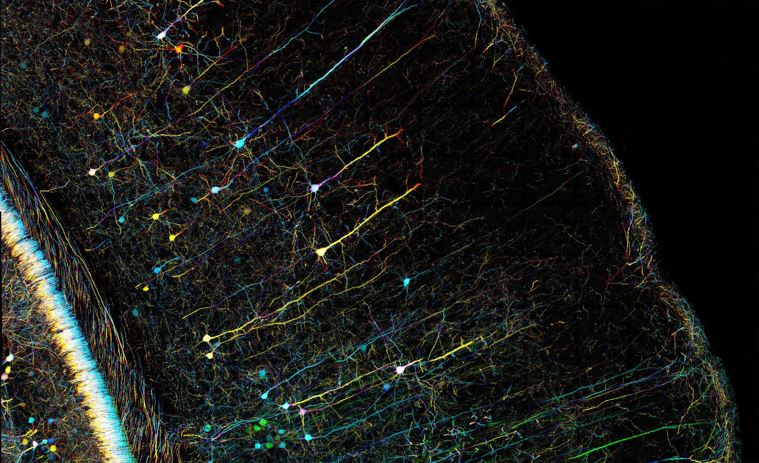
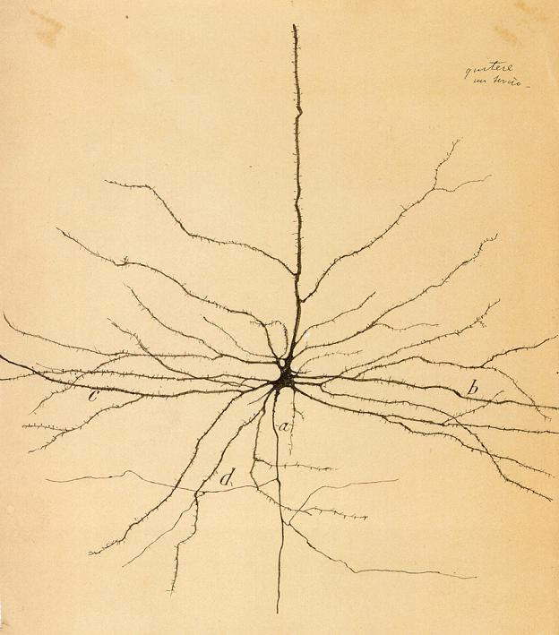
Microscopy and Imaging: Methods and Tools
Zeiss
Cajal

Slide 2
Objectives
Goals of microscopy
How is light manipulation achieved?
properties of light, lenses, filters
nuts and bolts of microscope objectives
how does fluorescence work
What types of microscopes exist and what problems do they address/create?

Slide 3
why microscopy

Slide 4
workflow is important
assuming you know your experiment -
sample prep (live/fixed? deep/at surface? etc)
the right tools for your sample (microscope)
post-processing/data analysis

Slide 5
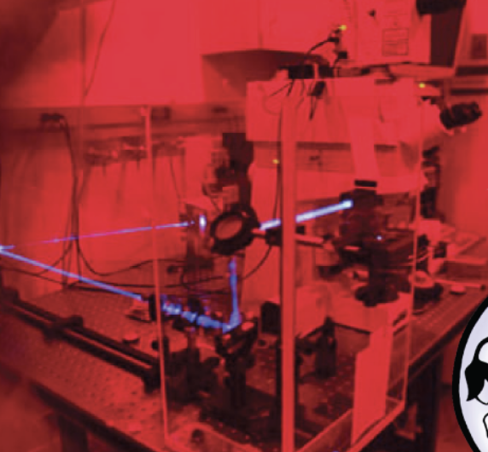
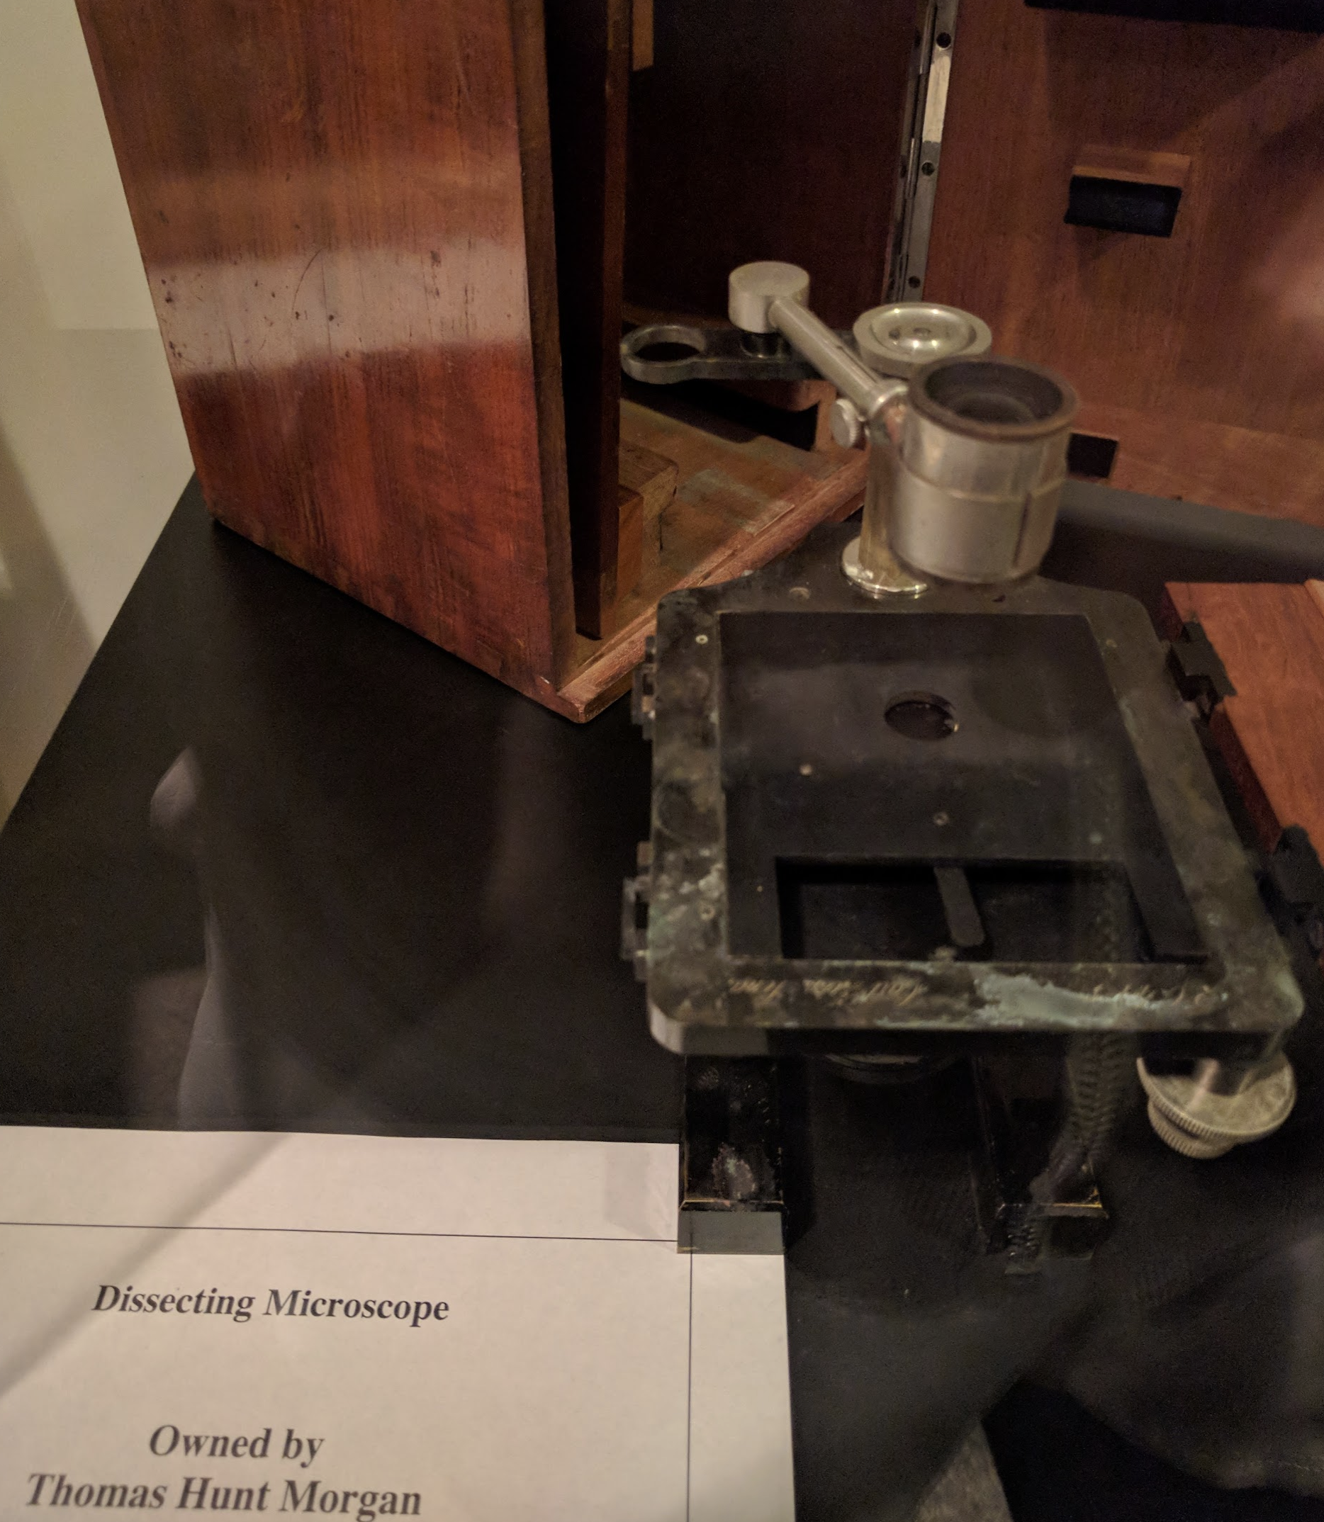
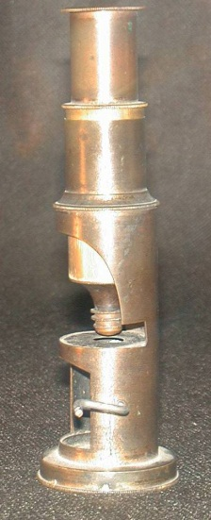
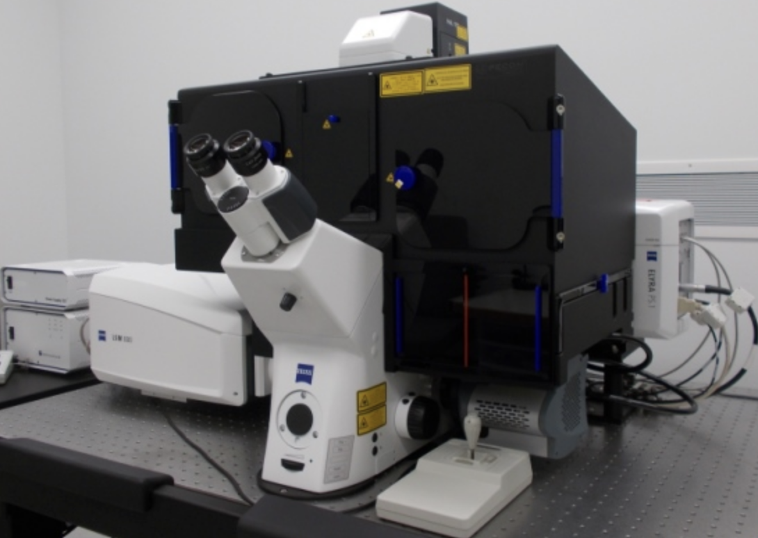
Microscopes - then to now
Photos: © J. Paul Robinson
zeiss 880 Elyra PS1

Slide 6
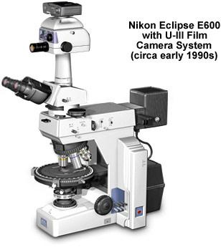
Basic Microscopes
A series of:
lenses
filters
mirrors
detectors
In order to focus the light on your sample
And be able to visualize/detect the sample
fluorescence source
white light
(transmitted)
white light
fluorescence source
emitted fluorescence

Slide 7
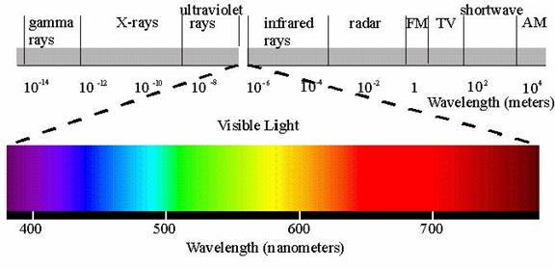
The Nature of Light
Dispersion
Separation of light into its constituent wavelengths when entering a transparent medium - the change of refractive index with wavelength, such as the spectrum produced by a prism or a rainbow

Slide 8
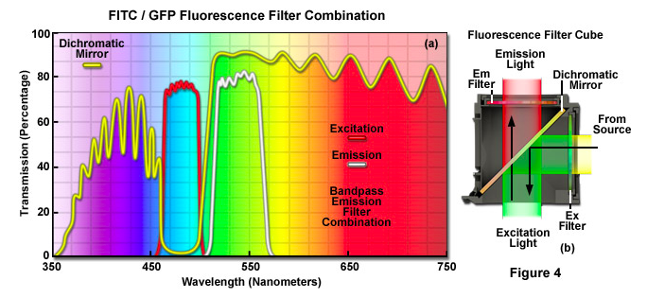
The Nature of Light
Absorption
When light passes through an object the intensity is reduced depending upon the color absorbed. Thus the selective absorption of white light produces colored light.
Zeiss

Slide 9
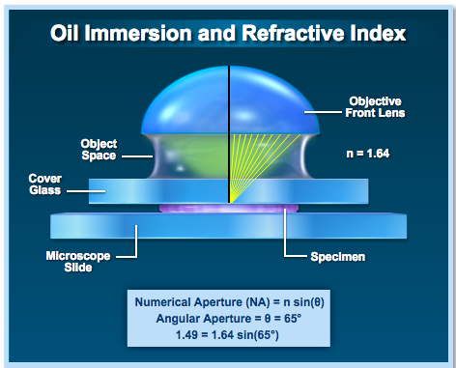
The Nature of Light
Refraction
Direction change of a ray of light passing from one transparent medium to another with different optical density. A ray from less to more dense medium is bent perpendicular to the surface, with greater deviation for shorter wavelengths
a
b
n1(sin(a)) = n2(sin(b))
n(vacuum) = 1
as n increases, the angle of refraction increases

Slide 10
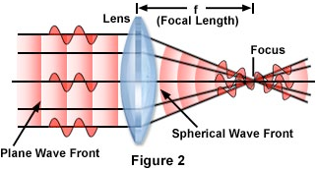
Wave Diagram Through a Perfect Lens

Slide 11
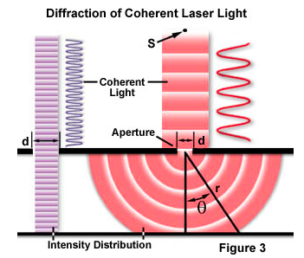
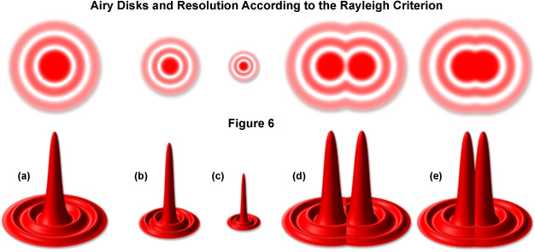
The Nature of Light
Diffraction
Light rays bend around edges - new wavefronts are generated at sharp edges - the smaller the aperture the lower the definition (more bending)
olympus

Slide 12
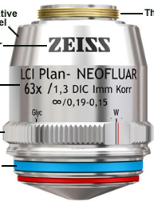
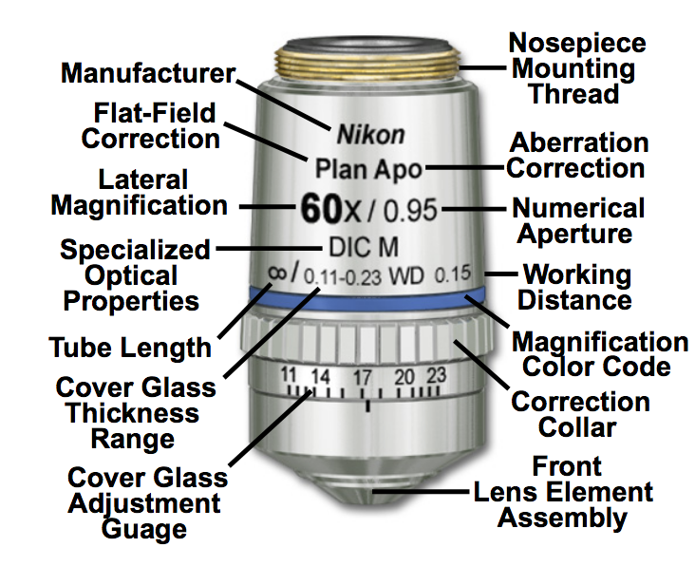
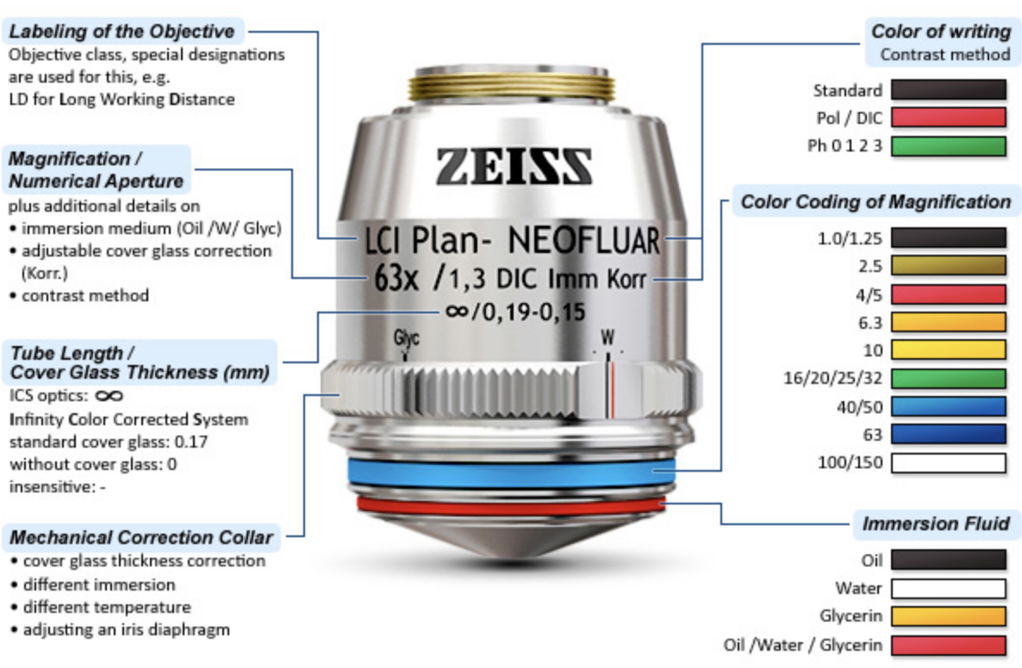
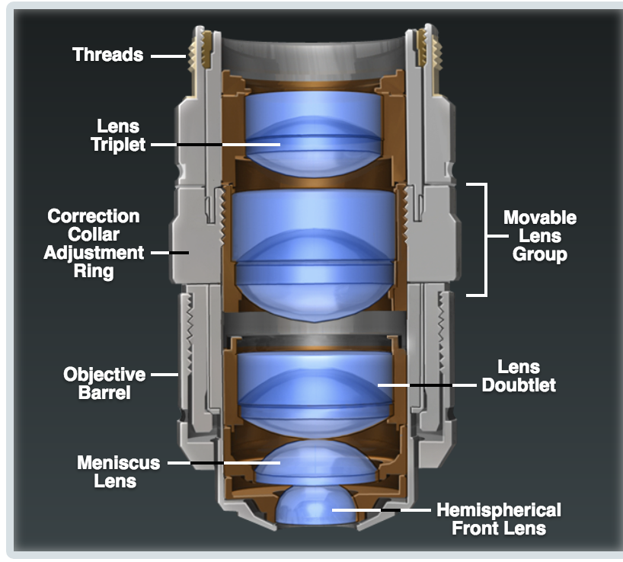
Objectives
In reality (for example using a core facility)
magnification
NA
working distance
immersion
adjustable pieces (immersion, cover glass)

Slide 13
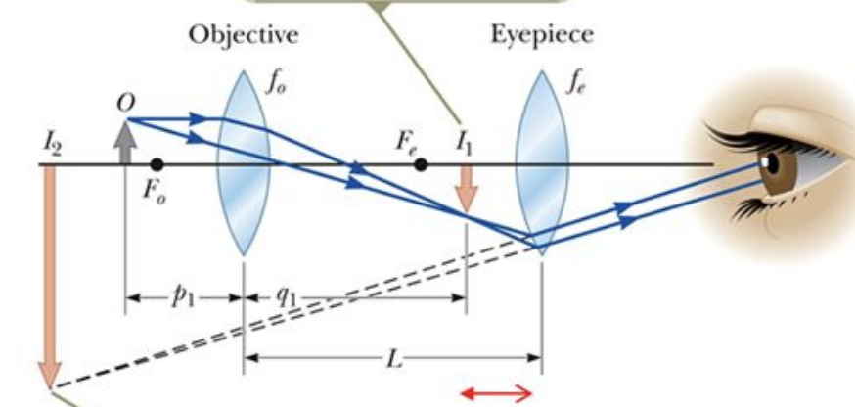
Magnification
I₁ = image of the objective
I₂ = Image of the eyepiece
f = focal lengths of the lenses
1/p + 1/q = 1/f
Magnification = - q/r
Magnification of the objective (40x, 25x etc) is not that informative because there are additional magnifications built into the microscope.
This is why we record scale bars.
NA is much more important...

Slide 14
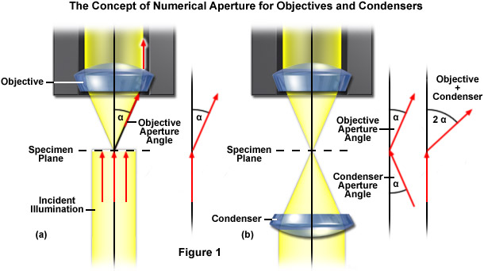
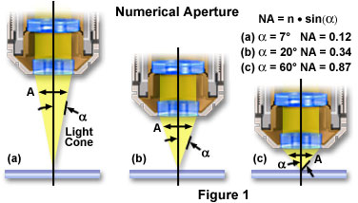
Numeric Aperture, N/A
The wider the angle the lens is capable of receiving light at, the greater its resolving power
The higher the NA, the shorter the working distance

Slide 15
Airy Disks
AD
PSF
As the Numerical Aperture of a lens increases, more of the diffraction rings are effectively collected and the disk is compressed – yielding higher resolution
Not
Resolved
Resolved
d (resolution) = 0.61 • (λ/NA)

Slide 16
Object Resolution and NA
Examples:
40 x 1.3 N.A. objective at 530 nm light
0.61
0.61 x 0.00053
=
= 0.25
NA
1.3
40 x 0.65 N.A. objective at 530 nm light
0.61
0.61 x 0.00053
= 0.405
=
0.65
NA

Slide 17
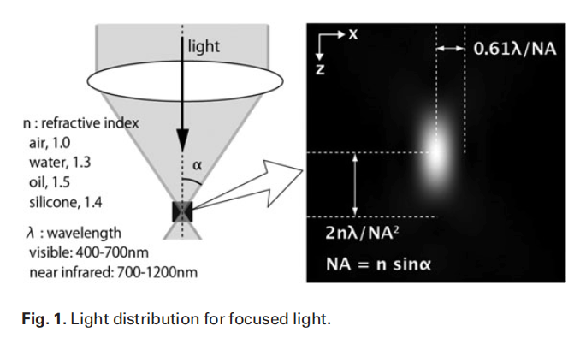
Z-resolution
0.61 
D_{x} = D_{y} =
NA
n 
D_{z} =
(NA)²

Slide 18
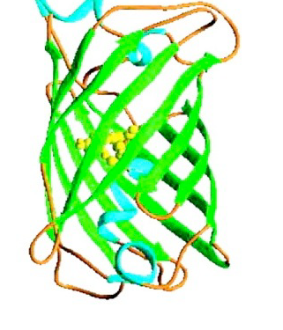
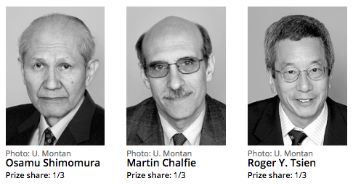
GFP Green Fluorescent Protein
GFP is from the chemiluminescent jellyfish Aequorea victoria (heavily mutated at this point)
Excitation maxima at 395 and 470 nm (blue). Peak emission at 509 nm (green)
Major initial application was as a reporter gene for assay of promoter activity
Now, it’s often fused to a protein of interest to track movement, localization, etc.
Requires no added substrates
Variations: split GFP, circularly permuted

Slide 19
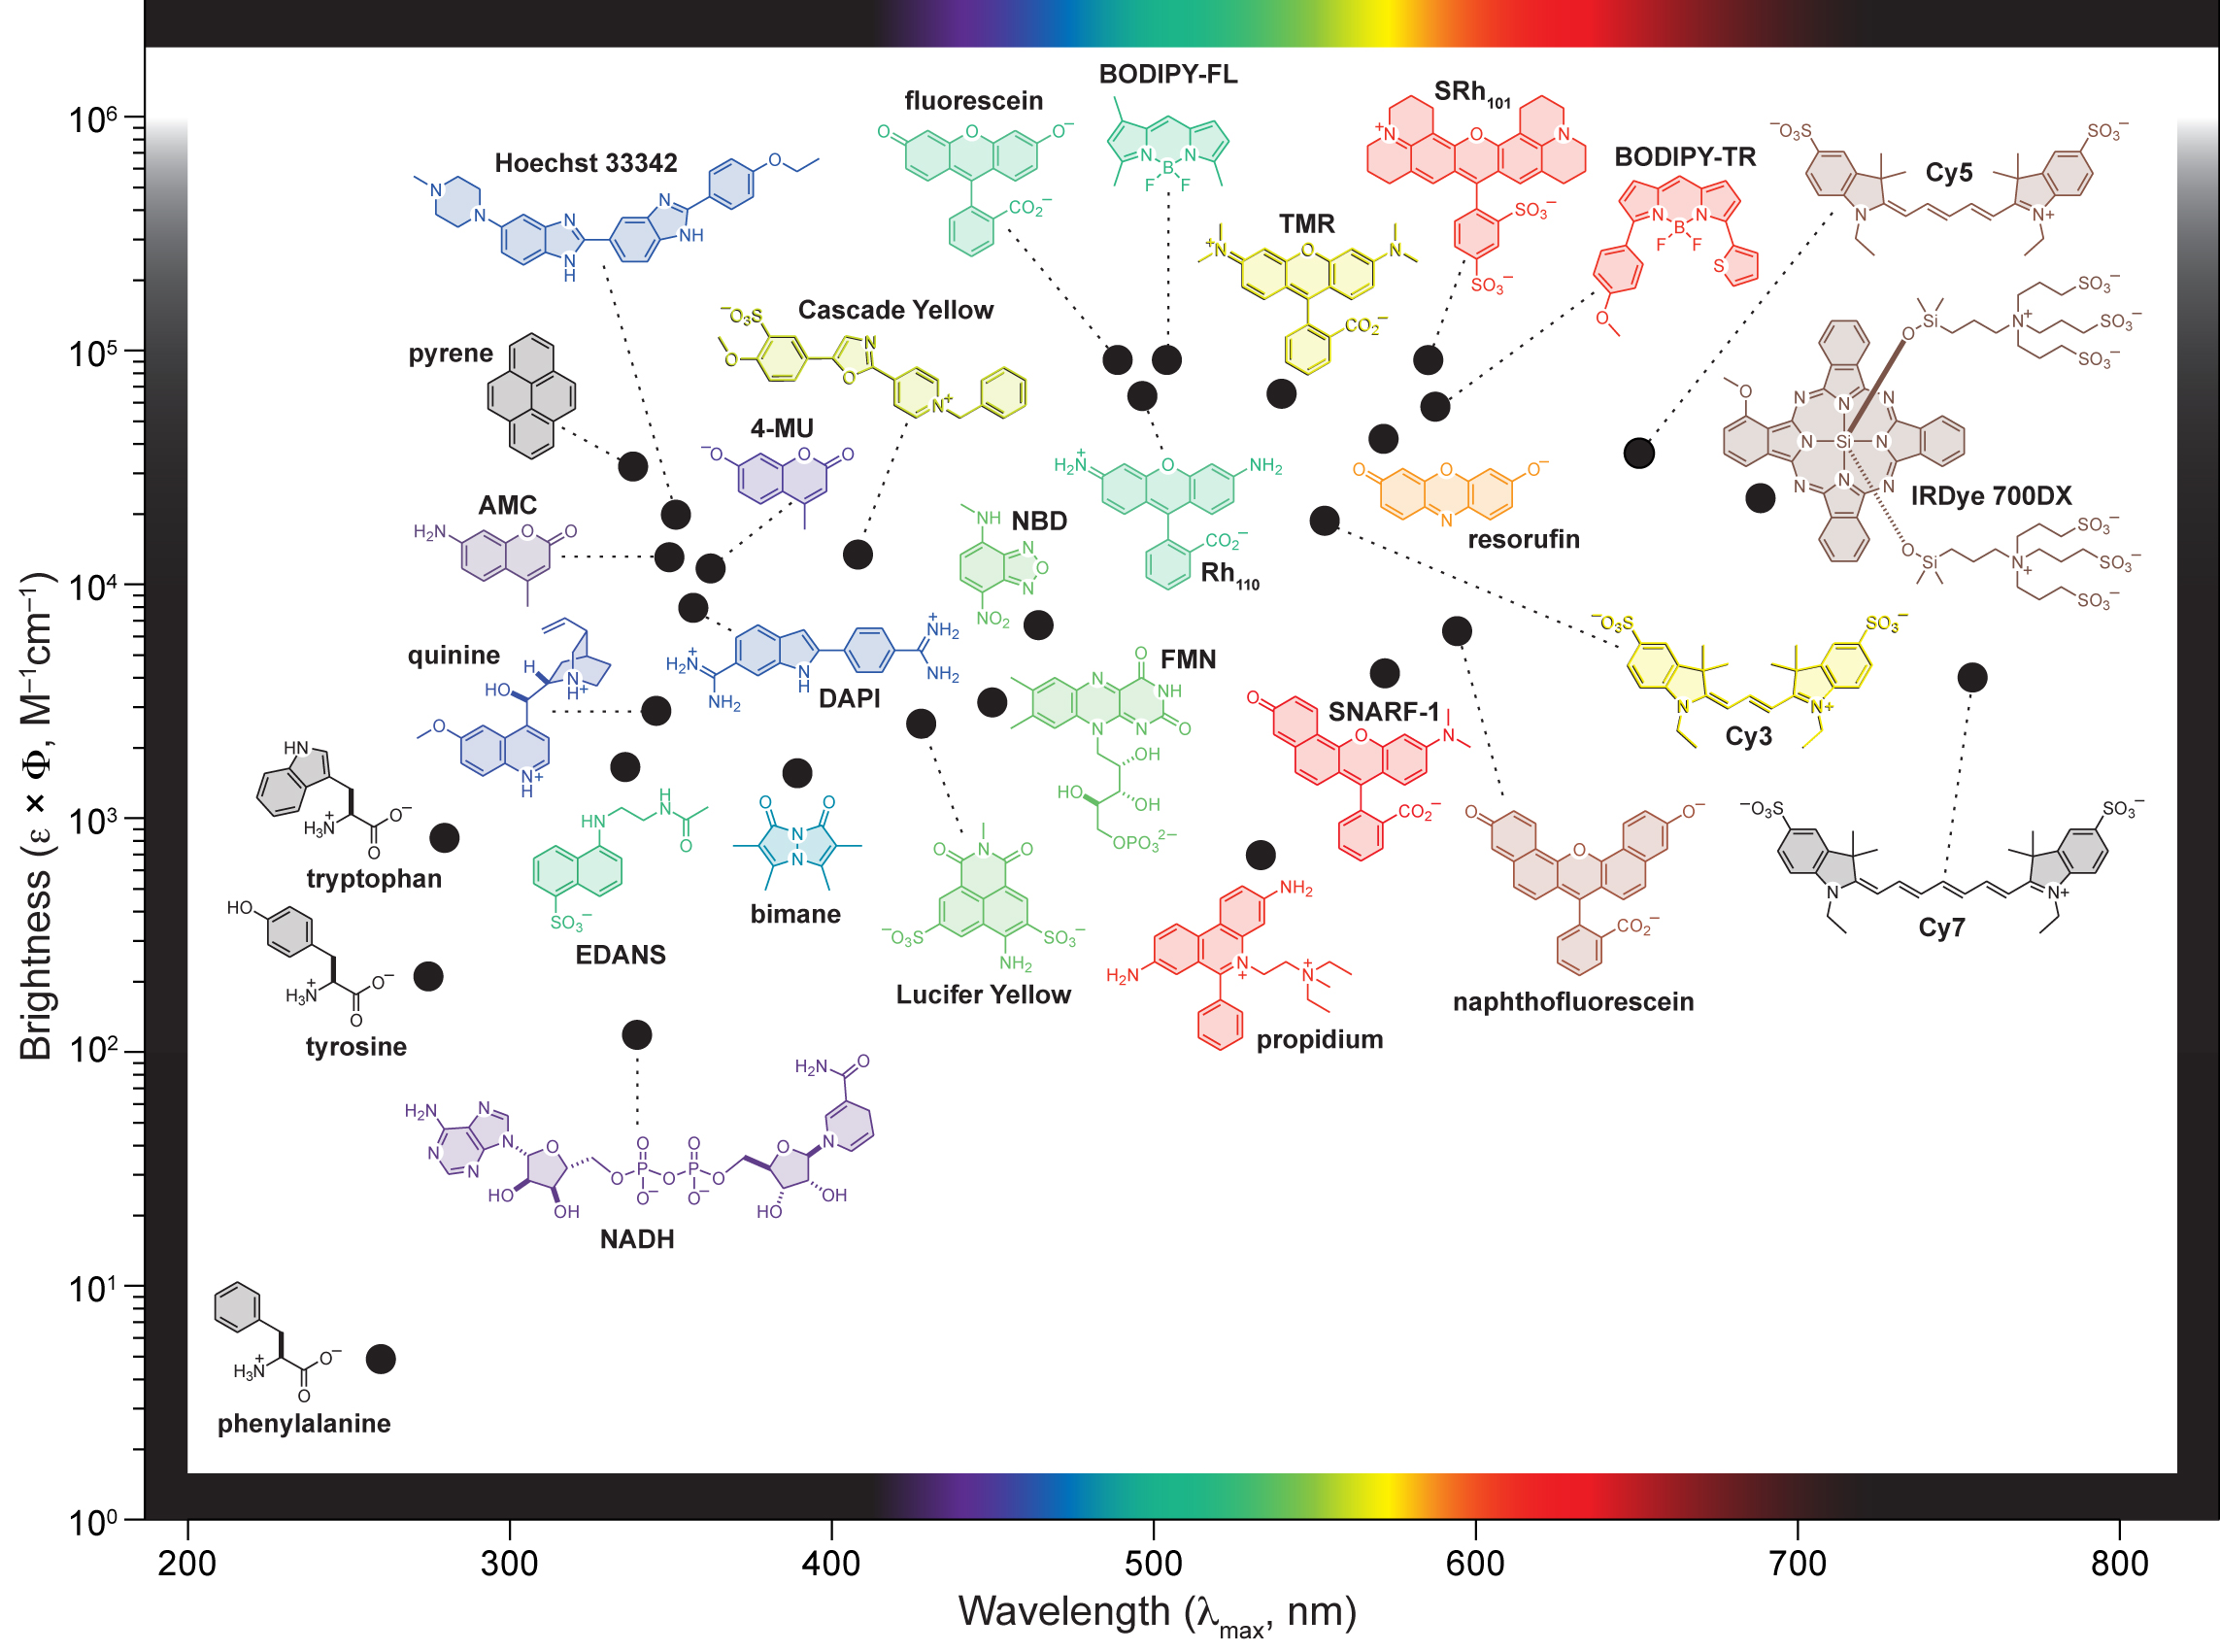
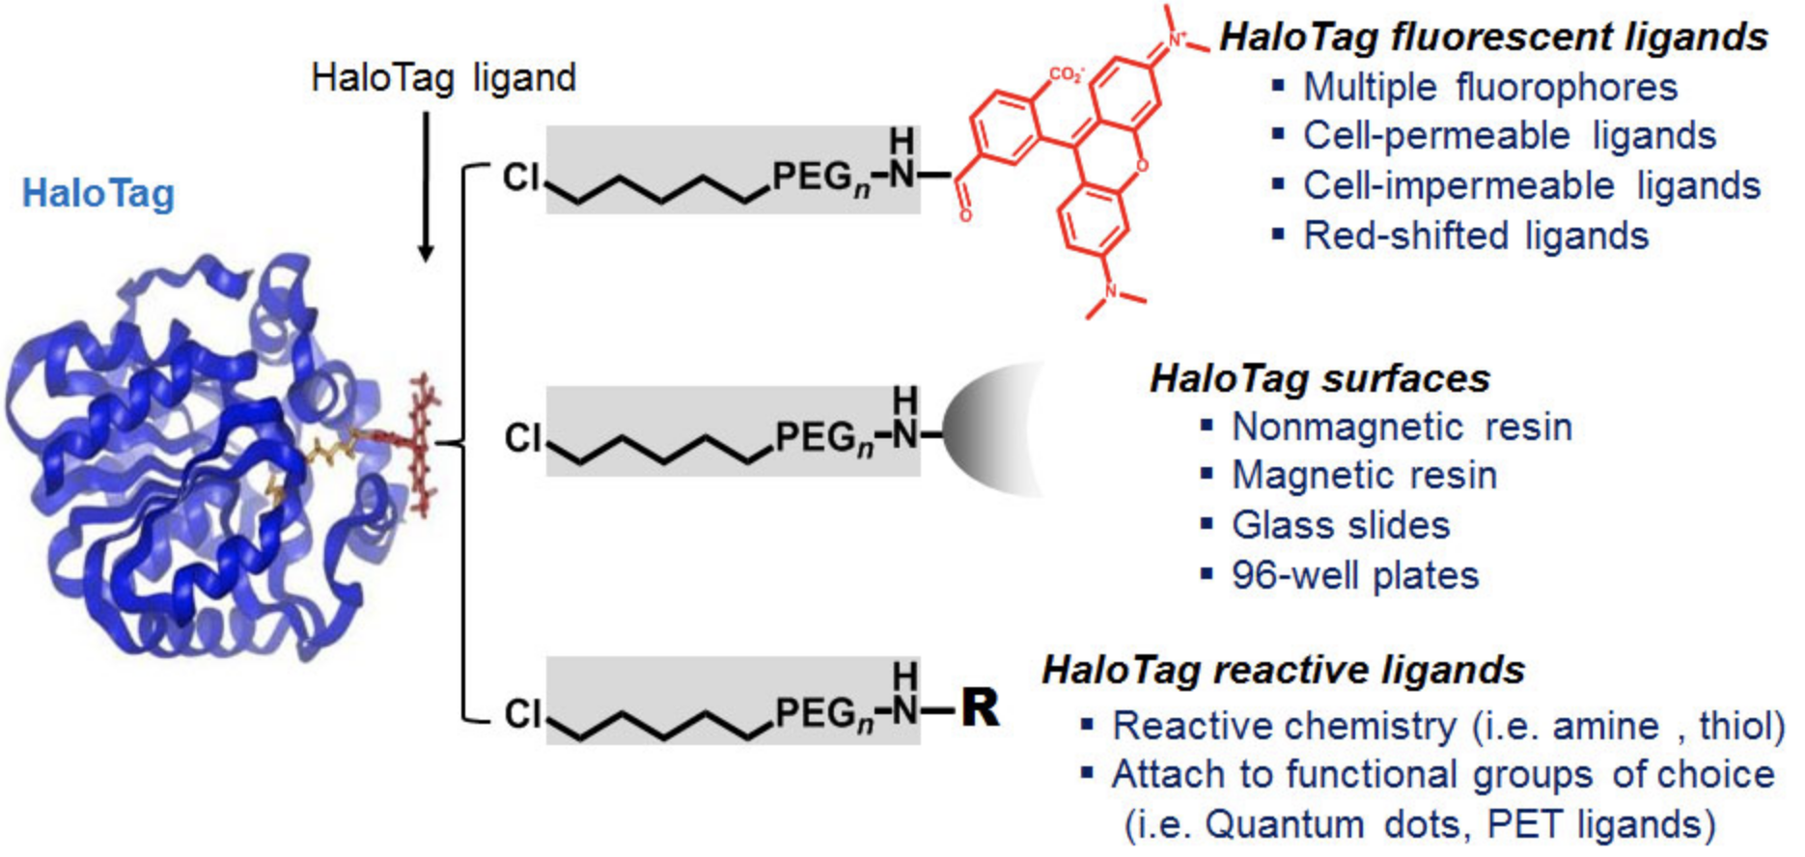
Dyes
Specificity was a problem
Newer tech like HaloTag/SNAP tag, DNA paint etc makes this easier
brighter fluors (Janelia)

Slide 20
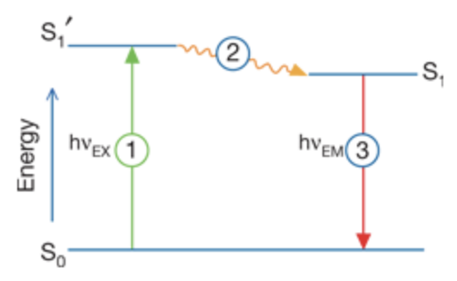
Simplified Jablonski Diagram
Excitation: a photon is absorbed by a fluorophore, leading to an excited state (S1’)
Excited state: While the fluorophore is excited, it can undergo many changes depending on its environment (e.g. photobleaching). If some of the energy of the S1’ state is lost, the fluorophore achieves another state, S1
Emission: As the S1 fluorophore returns to the ground state, a photon of energy is released. It has less energy (and therefore longer wavelength) than the excitation photon.
This fluorophore can be excited again.
thermofischer

Slide 21
Fluorescence
Stokes Shift
is the energy difference between the lowest energy peak of absorbance and the highest energy of emission (i.e., hv_{ex} - hv_{em})
Fluorescein
molecule
Stokes Shift is 23 nm
495 nm
518 nm
Fluorescence Intensity
Wavelength

Slide 22
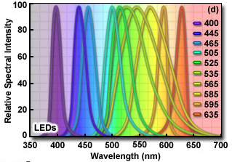
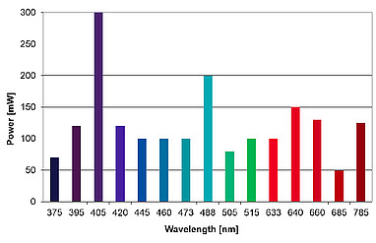
Excitation Sources
Lamps
Xenon
Xenon/Mercury
Lasers
Argon Ion (Ar)
Krypton (Kr)
Violet 405nm, 380 nm
Helium-Neon (He-Ne)
Helium-Cadmium (He-Cd)
Krypton-Argon (Kr-Ar)
LEDs
Laser Diodes

Slide 23
questions so far

Slide 24
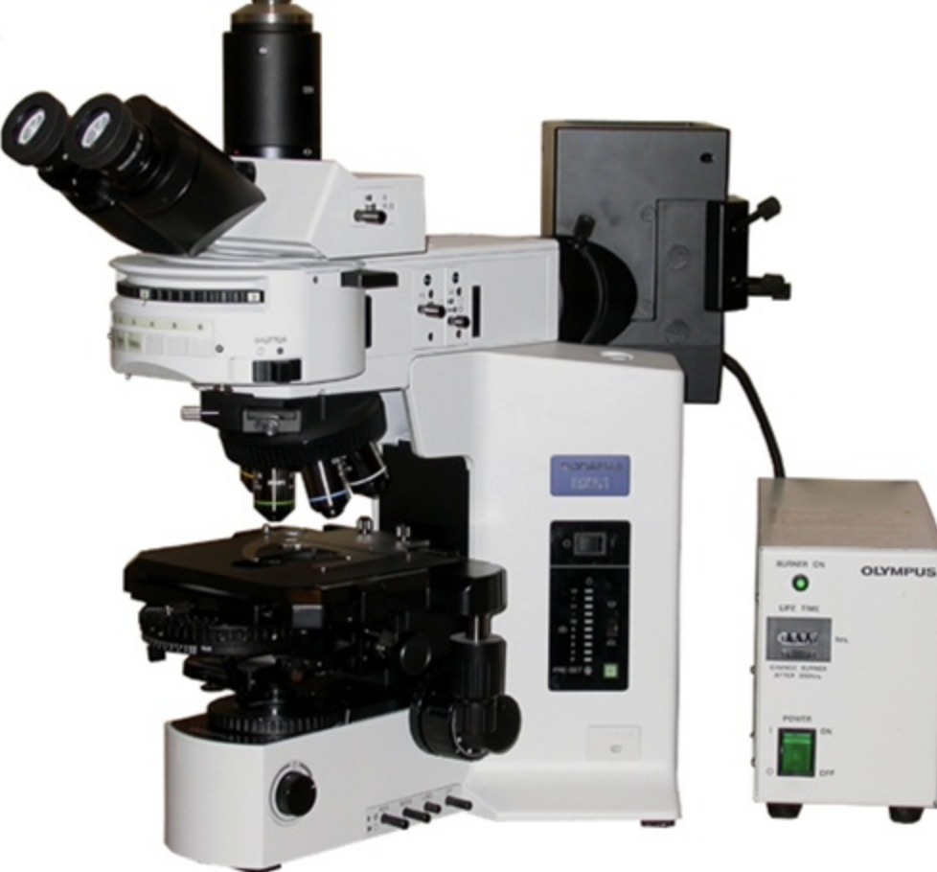
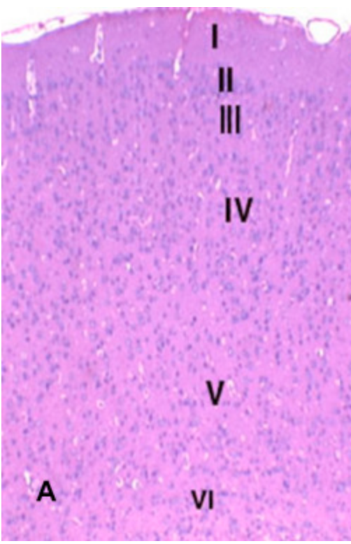
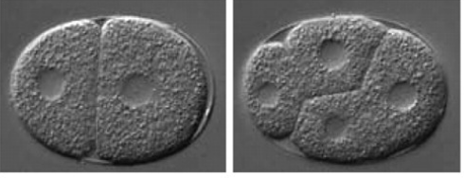
Transmitted light
Kohler illumination:
Ensures even illumination of the sample.
Lee et al 2004
El-Drieny et al 2015

Slide 25
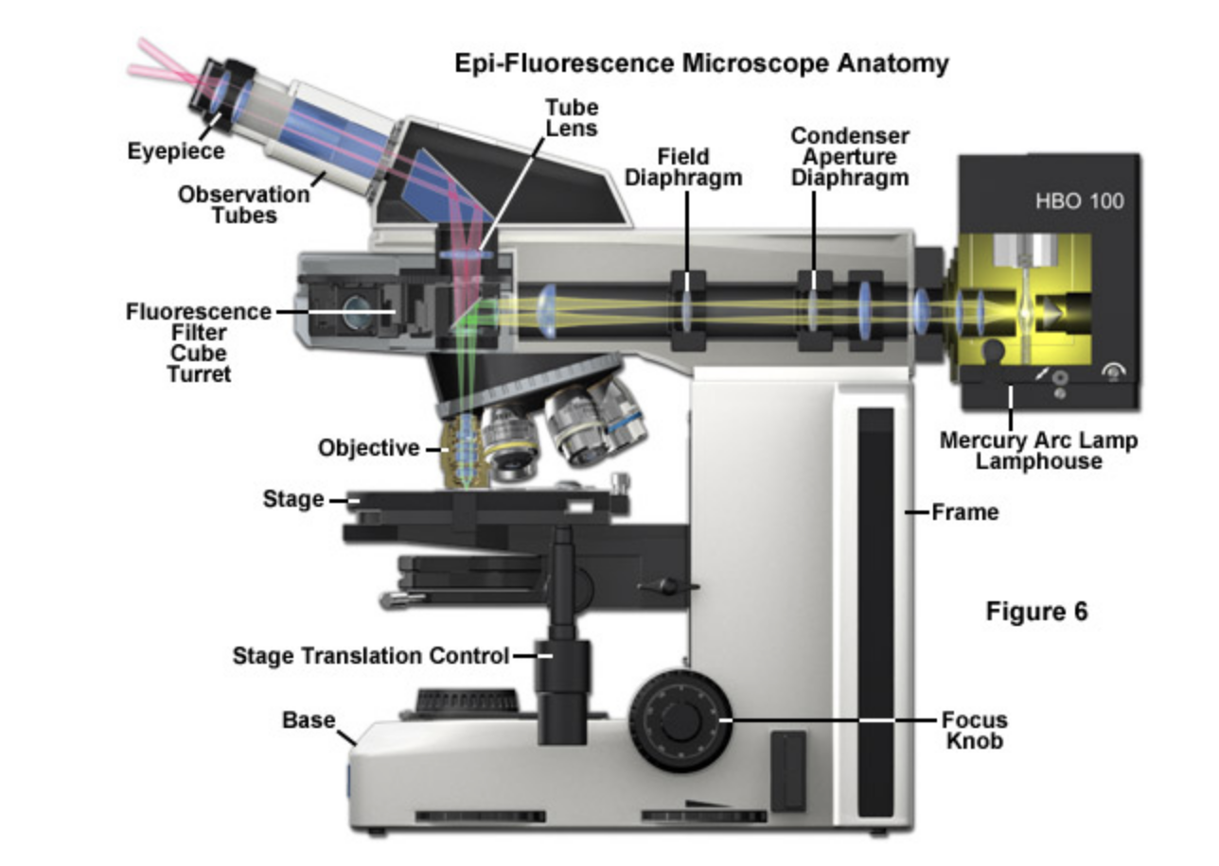
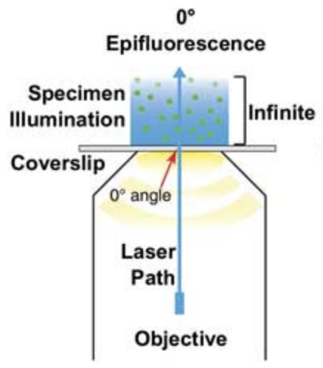
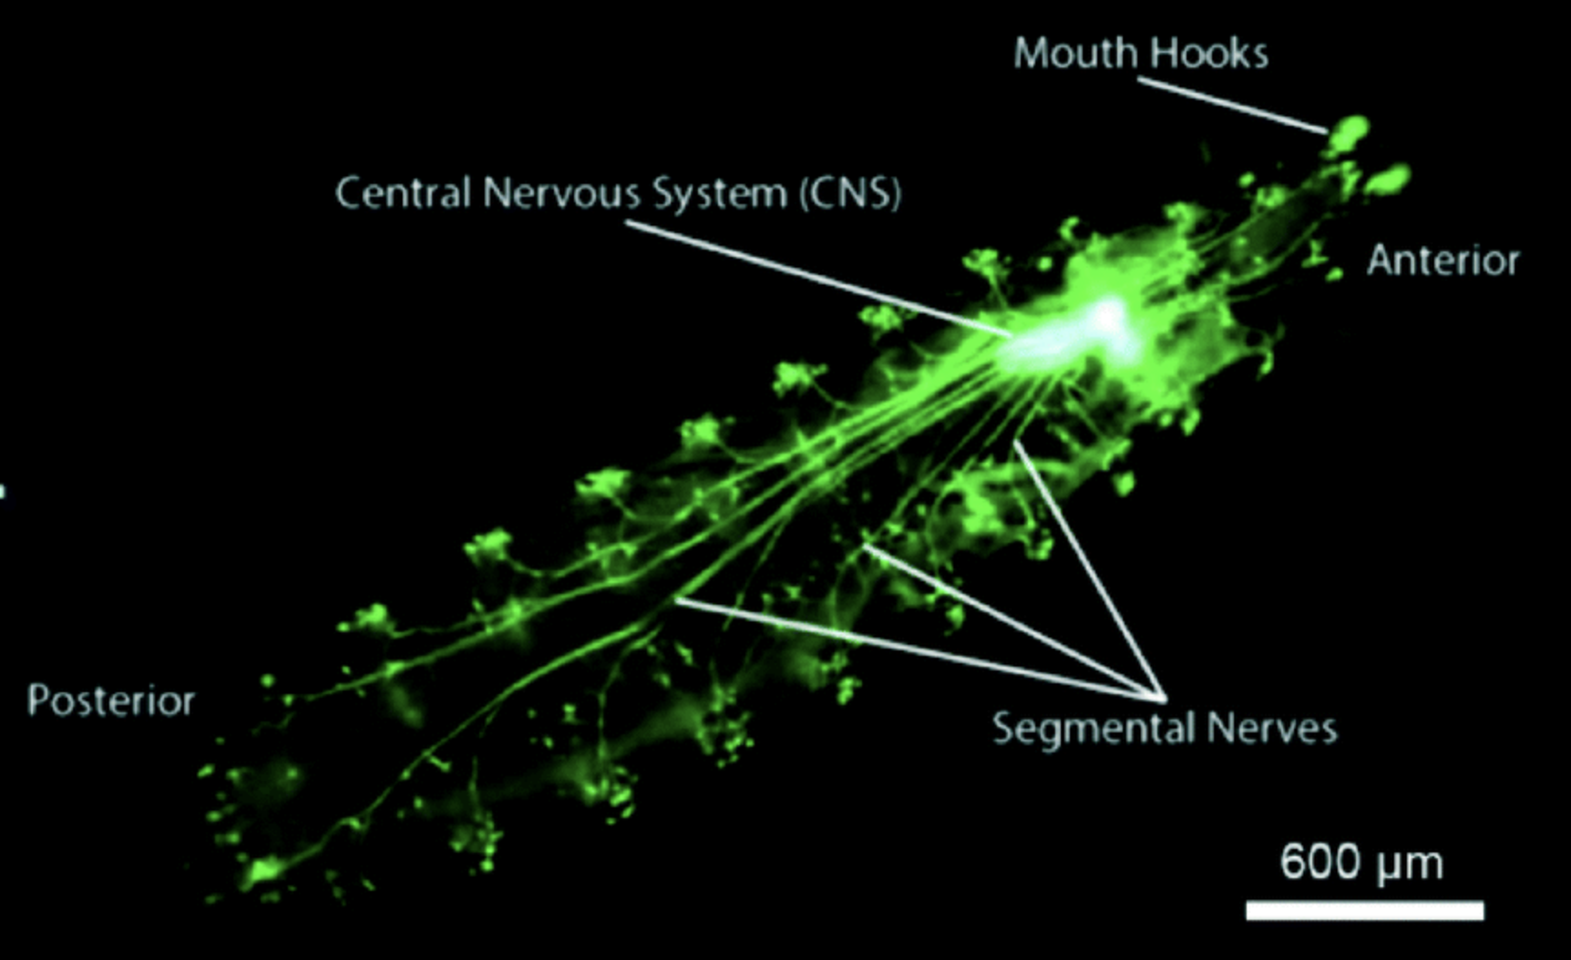
Epifluorescence
photonics.com
Ghaemi et al., 2014
Zeiss

Slide 26
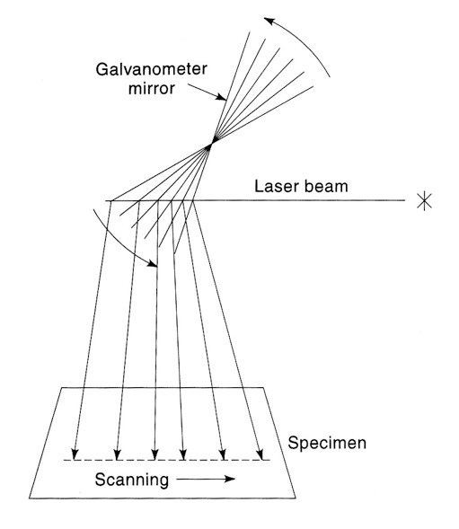
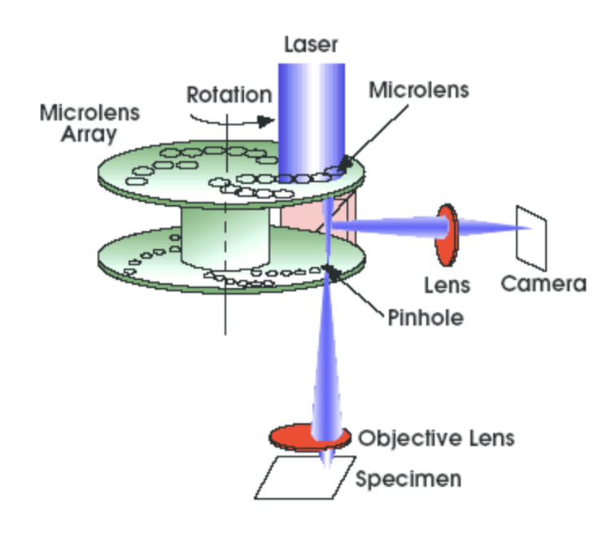
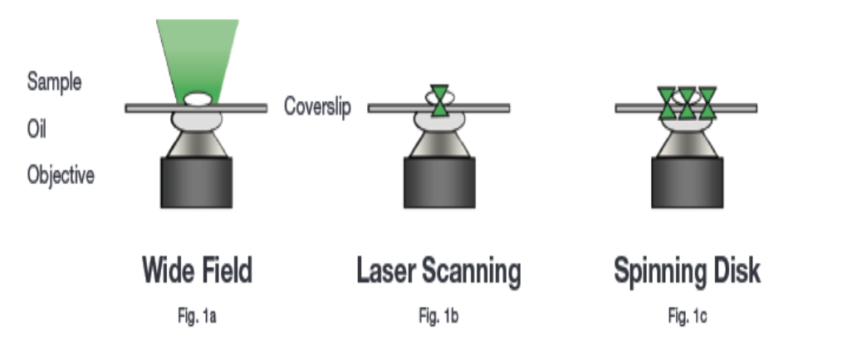
Confocal Microscopy
Perkin elmer

Slide 27
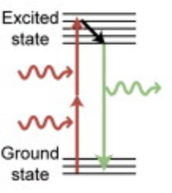
Two Photon
Basic concept:
instead of using 1 photon at X nm wavelength to excite a fluor,
use simultaneous 2 photons at a longer wavelength (less energy) to excite the fluor
emission doesn’t change
Strengths:
uses longer wavelengths which are less damaging, penetrate farther (up to about 1mm)
requirement for simultaneous absorption means excitation is restricted to the focal plane (inherently confocal)
Requirements:
specialized lasers to ensure you have enough photons to cause excitation
more photons = more power = problematic
pulsed lasers (e.g., Ti-Saph)

Slide 28
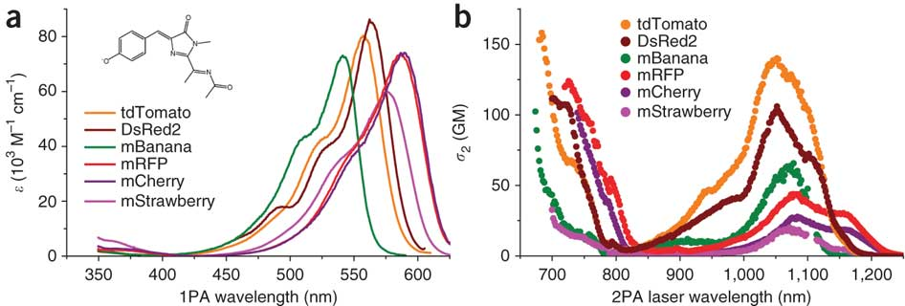
Two Photon
Drobizhev et al, 2011

Slide 29
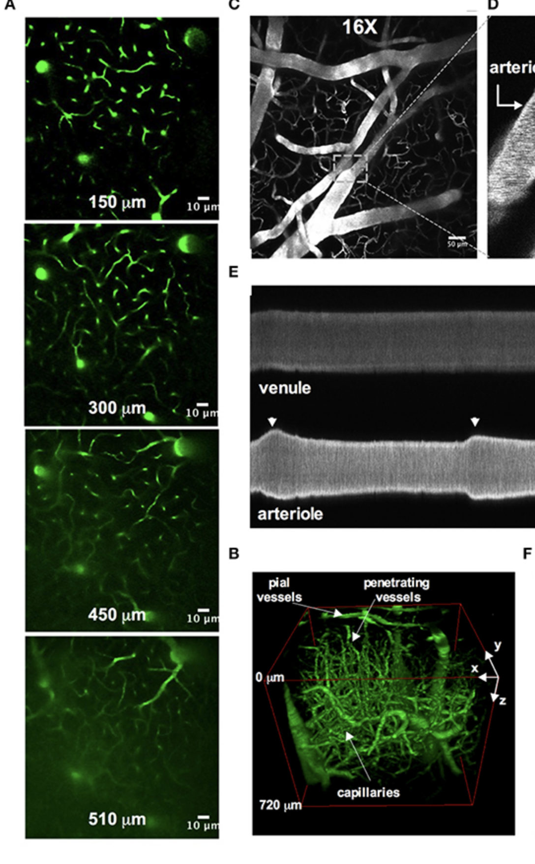
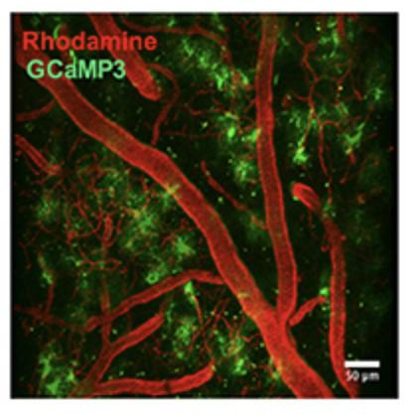
Two Photon
Tran & Gordon 2015
live imaging of mouse vasculature and astrocytes

Slide 30
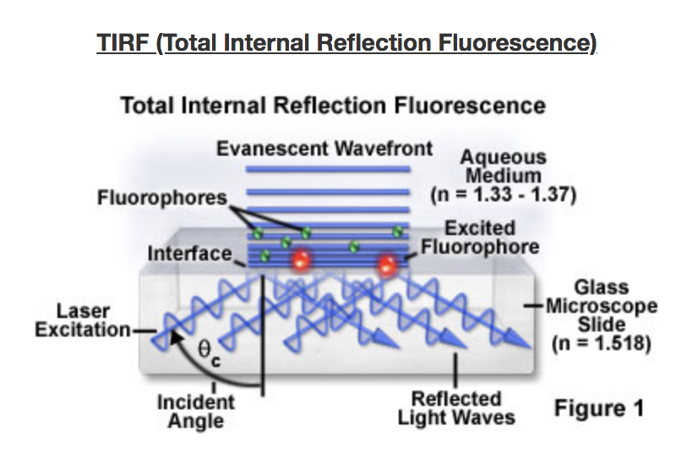
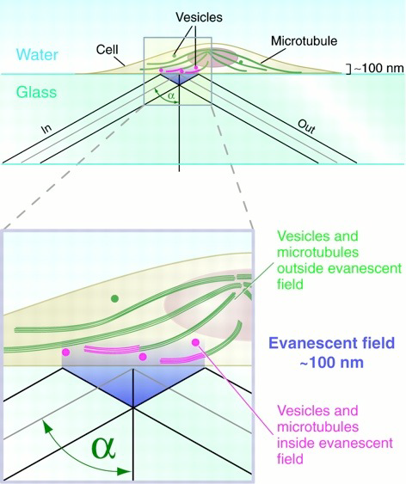
Total internal reflection microscopy (TIRF)
Stephens and Allan (2003). Science 300:82
Queen’s University

Slide 31
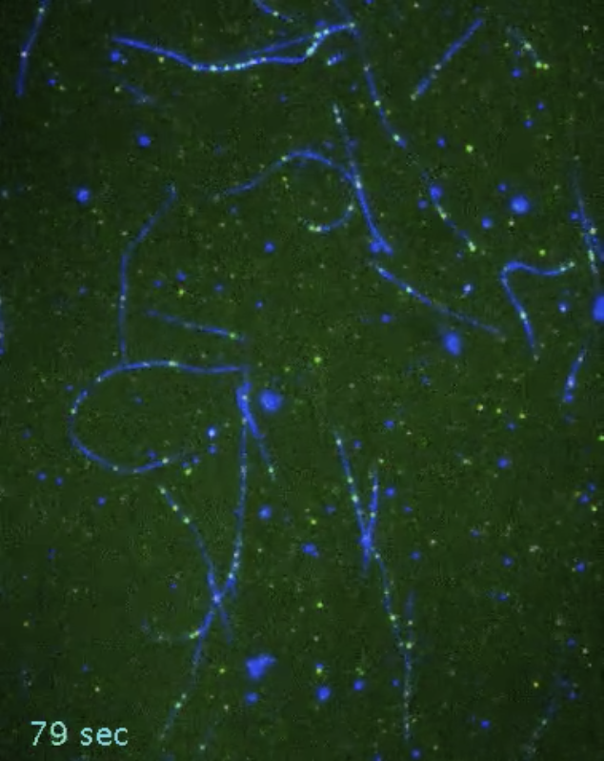
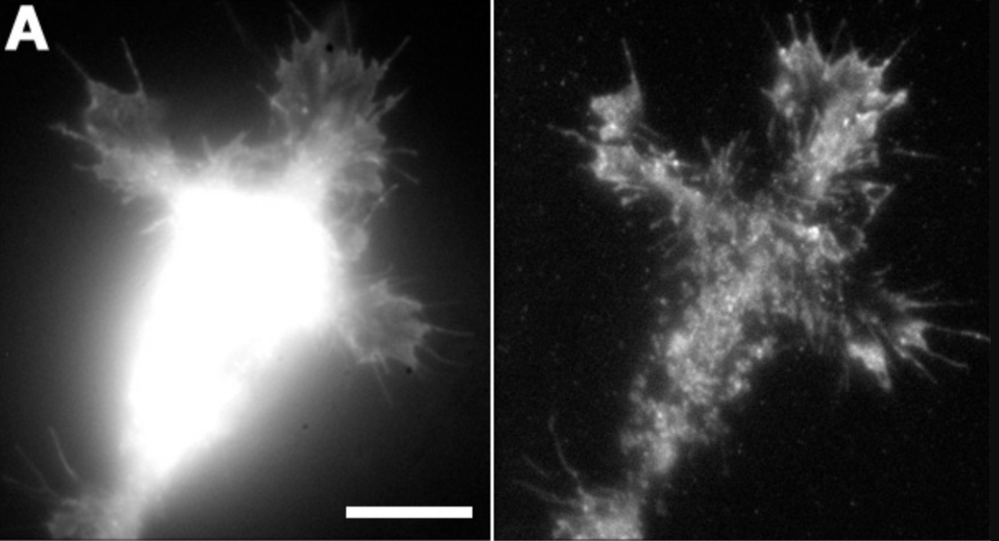
Total internal reflection microscopy (TIRF)
https://vimeo.com/157522768
GFP-arp3
WF
TIRF
Mongiu et al, 2007 JCS
Vale Lab, USCF

Slide 32
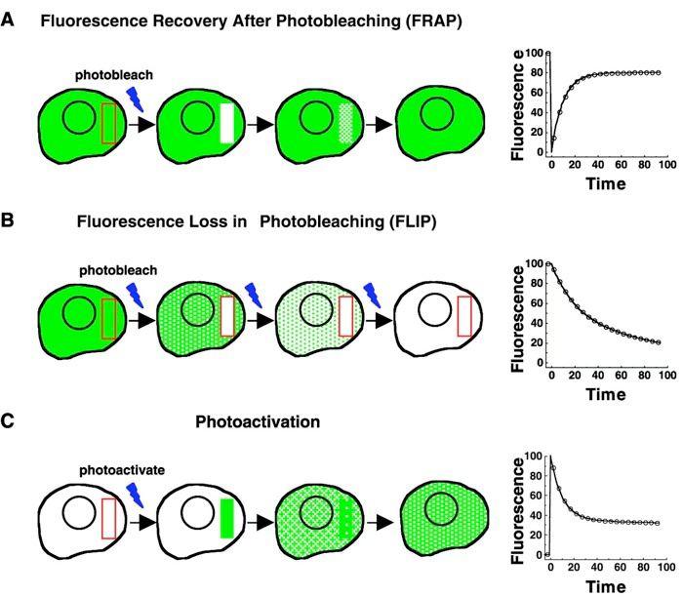
FRAP, FLIP, Photoactivation
Lippincott-Schwartz and Patterson (2003). Science 300:87

Slide 33
Forster Resonance Energy Transfer (FRET)
Molecule 1
Molecule 2
Molecule 1
Molecule 2
Fluorescence
Fluorescence
Fluorescence
ACCEPTOR
Intensity
Donor
Acceptor
Intensity
Wavelength

Slide 34
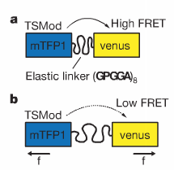
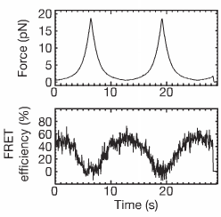
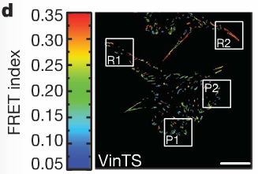
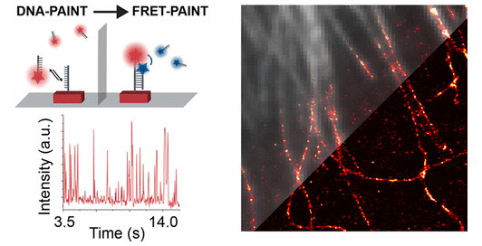
Forster Resonance Energy Transfer (FRET)
Grashoff et al 2010 Nature
Auer et al Nano Lett 2017

Slide 35

Forster Resonance Energy Transfer (FRET)

Slide 36

Light sheet/ SPIM
Nikon

Slide 37


Super Resolution
STED
Stimulated emission depletion
PALM
Photoactivated localization microscopy
STORM
Stochastic optical reconstruction microscopy
“De-excitation”
Second beam
Excitation
Focused PSF

Slide 38



More Super Resolution
SIM (structured illumination microscopy) - using a grid to change the illumination of the sample, then reconstruct the image in post-processing
AiryScan - using an array of hexagonal detectors, all incident light is collected and reassigned to the central position. Each detector acts like a pinhole, but contributes to a virtual pinhole (central position)
Pre processing: Expansion microscopy
Post processing: super-resolution radial fluctuations (SRRF)
Andor
Zeiss
WF
WF + SRRF
Gustafsson et al 2017 Nat Comm

Slide 39



Electron microscopy
Illumination is provided by a beam of electrons.
Transmission EM: Requires VERY thin samples.
Scanning EM: not passing the electrons through, rather detecting the ones emitted from the surface due to excitation. Not as good resolution.
CryoEM: refers mostly to sample prep - rapid freezing of the sample allows reconstruction of molecules in near-native states (pushing towards structural biology)
wikipedia

Slide 40
Resources
Nikon, Zeiss, and Olympus have very good online tutorials/guides to microscopy basics
Core facilities
Janelia research campus (AIC)
Cold Spring Harbor (
Woods Hole summer courses (2 on microscopy)

Slide 41


Paper for next week

